Slide 1
Workplace health and safety and COVID-19
Kelowna Chamber of Commerce
Shawn Mitton and Kira Berntson, Managers Prevention Field Services
May 14, 2020
Notes:
*Please review this presentation in advance and remove any slides on topics that may not be applicable to your audience. We have marked sections that are most likely applicable to certain industries as “[Optional]”.
[Introduce yourself]
WorkSafeBC recognizes the unique challenges faced by [insert industry] in keeping their workers healthy and safe during the COVID-19 pandemic. We are working with [insert industry] workers, employers, and industry associations across the province to ensure your workplaces remain healthy and safe during this challenging period.

Slide 2
Agenda
Understanding COVID-19
Controlling the risk of COVID-19 exposure in the workplace
WorkSafeBC support and other resources
Questions and answers
Notes:
In today’s presentation, I’ll be walking you through:
Basic information about COVID-19, including symptoms, how it spreads, and what to do if you or your workers experience flu-like symptoms.
Strategies to control the risk of COVID-19 exposure in the workplace, including focusing on the hierarchy or prioritization of controls, as well as what everyone at the workplace should be doing to prevent exposure.
Specific topics that are of particular interest to [insert industry], including [insert optional modules: psychological safety during a pandemic, best practices for the work-at-home office, and employment status, work sharing, and temporary work]
I’ll then give you a brief orientation on what employers and workers should know about COVID-19 related claims
And finally, I’ll let you know what resources we have to support you and leave a few minutes at the end to answer any questions.
I’ve got about [insert time: 30-45 minutes] for this webinar, so if I don’t have time to answer your question, my final slide will include my contact details, and you’re welcome to feel free to connect with me at any point, if you’d like to discuss anything further.
Before I begin, I want to note that the COVID-19 situation is rapidly evolving and the content of this webinar is accurate and current as of the time of creation, which was in late April of 2020.

Slide 3
Understanding COVID-19

Slide 4
COVID-19 symptoms and transmission
Coronaviruses are a large family of viruses that can cause diseases ranging from the common cold to more severe diseases. COVID-19 is the name of the disease caused by a newly identified coronavirus.
Symptoms
Include coughing, sneezing, sore throat, difficulty breathing, fever
Can range from mild to severe and can appear up to 14 days after exposure
Transmission
The virus is transferred by infected droplets coming in contact with the eye, nose, or mouth through:
Close contact with other people
Touching contaminated surfaces or people
Source: BC Centre for Disease Control
Notes:
COVID-19 is a virus that can cause respiratory illness and can lead to hospitalization and death.
Older people, people with a weakened immune system, and people with underlying health issues (including heart disease, diabetes, and lung disease) are at a higher risk for sever disease, but younger and otherwise healthy people are also at risk.
The symptoms of COVID-19 are similar to other respiratory illnesses including the flu and common cold. They include:
Coughing
Sneezing
Sore throat
Difficulty breathing
Fever *Average normal body temperature taken orally is about 37°C. For more on normal body temperature and fevers, see HealthLinkBC's information for children age 11 and younger and for people age 12 and older.
Other symptoms may include: muscle aches, fatigue, sore throat, headache, loss of appetite, chills, runny nose, nausea and vomiting, diarrhea, and loss of sense of smell or taste.
People infected with COVID-19 may experience little or no symptoms with illness ranging from mild to severe. Watch for symptoms of COVID-19 that can appear up to 14 days after being exposed to the virus.
How it spreads:
Coronavirus is transferred by infected droplets contacting surfaces of the eye, nose, or mouth.
Coronavirus is transmitted via liquid droplets when a person coughs or sneezes. These droplets typically spread only one to two metres and quickly fall to the ground; however the virus can enter through the eyes, nose or mouth if you are in close contact. The virus is not known to be airborne (e.g. transmitted through the particles floating in the air) and it is not something that comes in through the skin.
It can be spread by touch if a person has used their hands to cover their mouth or nose when they cough. That’s why its recommend you cough or sneeze into your arm, avoid touching your face, and wash your hands regularly. It can also occur if you touch a contaminate surface or an infected person, for example, when shaking hands.
Source: http://www.bccdc.ca/health-info/diseases-conditions/covid-19/about-covid-19

Slide 5
COVID-19 transmission risk factors
The following factors increase likelihood of transmission via person-to-person contact:
Challenges maintaining 2 metres of distance
High frequency of unique persons at the workplace (e.g., customers or clients)
Potential to work in enclosed areas
Potential for sustained group interaction
Probability of infected persons
Inadequate self-isolation practices
The following increases likelihood of transmission via surface contact:
Potential for regular contact with shared surfaces
Notes:
If the following conditions exist within a workplace, the risk of the COVID-19 virus being transmitted from person-to-person, or from coming into contact with surfaces, will increase. [Read slide]

Slide 6
What to do if you, or your workers, experience flu-like symptoms
Anyone experiencing flu-like symptoms associated with COVID-19, should:
Immediately inform their supervisor.
Physically distance from colleagues and leave the workplace.
Seek medical advice from a health care professional:
Call 911, if urgent.
Use the COVID-19 BC Support App and Self-Assessment Tool at https://bc.thrive.health/.
Call 811 for health advice.
Consult with a health care provider before returning to work.
Source: BC Centre for Disease Control
Notes:
Anyone experiencing flu-like symptoms associated with COVID-19, should immediately inform their supervisor, physically distance from any other people, leave the workplace and seek medical advice from a healthcare professional.
You can call 811 anytime to talk to a nurse at HealthLinkBC and get advice about how you are feeling and what to do next.
A self-assessment can also be performed using an online tool to determine whether further assessment or testing for COVID-19 is needed.
Anyone exhibiting any of these symptoms, should NOT be at work and should consult with their healthcare provider before returning to work.
Source: http://www.bccdc.ca/health-info/diseases-conditions/covid-19/about-covid-19/if-you-are-sick

Slide 7
Controlling the risk of COVID-19 exposure in the workplace

Slide 8
Participant poll
Barriers to controlling the risk of COVID-19 exposure (choose one):
My workplace understands the risk and how it applies at my worksite.
My workplace understands the risk and how to effectively control it.
My workplace understands the risk and how to effectively control it, but we are not implementing effective controls.
Notes:
Before I begin discussing control measures, I’d like to get a sense of the barriers your workplace is facing; whether your workplace understands the risk of COVID-19 exposure, the various control measures and what your workplace’s current practices are.
[Ask the audience how they would respond to this question.]

Slide 9
Basic control measures
Follow the orders, notices, and guidance from the provincial health officer and the BC Centre for Disease Control.
The basics
Physical distancing (2 metres / 6 feet)
Cleaning and disinfecting
Personal hygiene:
Cover your coughs and sneezes with a tissue or use your elbow.
Wash your hands.
Avoid touching your face.
Do not share food, drinks, or items.
Source: BC Centre for Disease Control, Government of BC
Notes:
There are many things you can do to prevent the spread of COVID-19 in your workplace; however, the most important is following the orders, notices, and guidance from the provincial health officer, and applying them to the workplace.
Physical distancing means limiting close contact with others. When outside of your home, practicing social distancing by keeping two meters (six feet) away from one another is something we can all do to help stop the spread of COVID-19.
Cleaning your environment with regular, household cleaning products can help prevent the spread of illness including COVID-19, focusing on frequently touched surfaces and items.
Cover your mouth and nose with a disposable tissue or the crease of your elbow when you sneeze or cough. Wash your hands often with soap and water for at least 20 seconds. Using soap and water is the single most effective way of reducing the spread of infection. If soap and water are not available, alcohol based hand rubs (ABHR) can be used to clean your hands as long as your hands are not visibly soiled. If they are visibly soiled, use a wipe and then ABHR to effectively clean them. Do not touch your face, eyes, nose, or mouth with unwashed hands. Do not share food, drinks, utensils, etc.
Source:
http://www.bccdc.ca/health-info/diseases-conditions/covid-19/prevention-risks
https://www2.gov.bc.ca/gov/content/health/about-bc-s-health-care-system/office-of-the-provincial-health-officer/current-health-topics/covid-19-novel-coronavirus

Slide 10
Reduce risk with the hierarchy of controls
Elimination or Substitution
Work from home
Most effective
Engineering
Physical barriers
Administrative
Cleaning & disinfecting
PPE
Gloves & masks
Least effective
Notes:
The hierarchy of controls is a system that guides people to choose the most effective ways to remove hazards and reduce risk in the workplace. The idea behind this hierarchy is that the control methods at the top of graphic are more effective and protective than those at the bottom.
When selecting a safeguard or a combination of safeguards, always start at the top of the hierarchy. Choose a less effective safeguard only when more effective solutions are impracticable. Controls should be developed in consultation with your joint health and safety committee or worker representative, where appropriate, and continuously monitored to ensure they are providing the best level of protection to workers.
Hierarchy of controls
Elimination or substitution: This involves removing the risk of exposure entirely from the worker. This could involve eliminating work tasks, postponing, re-organizing, or planning work in such a way that workers are not at risk of exposure to COVID-19. Having workers work remotely would be an example or eliminating the risk from the workplace.
Engineering controls: If elimination or substitution is not an option, using an engineering control is the next best choice. These controls are designed to remove the hazard at the source, before it comes in contact with the worker. These are physical changes in the workplace, such as installing a barrier between workers or between workers and others (e.g. plexiglass barriers at a grocery store check-out).
Administrative controls: This lesser effective control involves altering work practices to minimize exposure, such as changing work procedures, training, and signage. Examples include minimizing the numbers of customers inside a store, staggering work shifts, putting posters up around the worksite reminding workers of personal hygiene best practices, and enhancing cleaning protocols.
Personal protective equipment (PPE): PPE is the least effective control and this last form of protection should only be considered after careful consideration of the previous control measures. PPE could be gloves, mouth masks, respirators, face shields, etc. While using PPE is important, it is not always enough to keep you safe. Some workplaces have specific requirements for PPE, such as in health care settings.
*It is important to consider the effectiveness of safety measures and their position on the hierarchy when choosing appropriate control measures to reduce risk of exposure to COVID-19. At the top of the hierarchy are system-level measures such as elimination or substitution, and engineering controls. These types of controls are more effective than safety measures such as administrative signs, procedures and training, and personal protective equipment. Using system-level controls ensure the highest level of safety.*

Slide 11
Participant poll
My workplace is using the following types of controls (choose all that apply):
Elimination or substitution
Engineering
Administrative
PPE
Not using controls
Notes:
Now that I’ve discussed various control measures, I’d like to get a sense of where your workplace is CURRENTLY at with using the hierarchy of controls to reduce risk of exposure to COVID-19.
[Ask the audience how they would respond to this question.]

Slide 12
What employers should do
General guidance
Determine who should be at the workplace:
Create policies that are in line with the recommendations and emergency measures laid out by the provincial health officer and the BC Centre for Disease Control.
Consider engineering controls (e.g. plexiglass barriers).
Implement physical distancing measures:
Reconfigure how the workplace is set up.
Stop in-person meetings and revise shift schedules.
Change work processes and practices.
Source (image): The Canadian Press
Notes:
WorkSafeBC expects employers to fully assess the risks of worker exposure to COVID-19 and develop control measures that specifically address those risks and prevent exposure to COVID-19. Employers should apply the orders and guidance from the provincial health officer and the hierarchy of controls.
This is a summary of what we presented earlier, but it bears repeating.
Employers must take all necessary precautions to minimize the risk of COVID-19 transmission and illness to themselves, workers, and others at the workplace. Businesses may consider some of the following advice or best practices at their worksite to reduce the risk of worker exposure to COVID-19. You may also wish to review our industry information pages for preventative measures to protect workers in specific industries from COVID-19.
Determine who should be at the workplace, as a way to eliminate exposure
- Implement a policy requiring anyone with symptoms of COVID-19 to self-isolate at home for a minimum of 10 days from onset of symptoms, as well as anyone advised by a provincial public health officer to self-isolate and to follow the instructions they receive.
- Implement a policy requiring anyone who has arrived from outside of Canada, or who is a contact of a confirmed COVID-19 case, to self-isolate for 14 days and monitor for symptoms.
- Work from home
Prioritize the work that needs to occur at the workplace to help your business operate. Employers may want to consider whether any of their workers can work remotely (for example, work at home). Should this be practicable, be aware that many health and safety roles, rights, and responsibilities are just as applicable for at-home workers as they are for more traditional workplaces. More about health and safety responsibilities when working from home will be shared later in this presentation.
Remember the hierarchy of controls and implement any Engineering controls, such as plexiglass barriers
Physical distancing at the workplace
If practicable, reconfigure the workplace to maintain appropriate distance between workers and customers.
Eliminate in-person team meetings or modify them to incorporate technology such as conference calling and online meetings.
Modify work processes and practices to encourage physical distancing, such as instructing workers to not greet one another or customers by shaking hands.
Post occupancy limits in elevators.

Slide 13
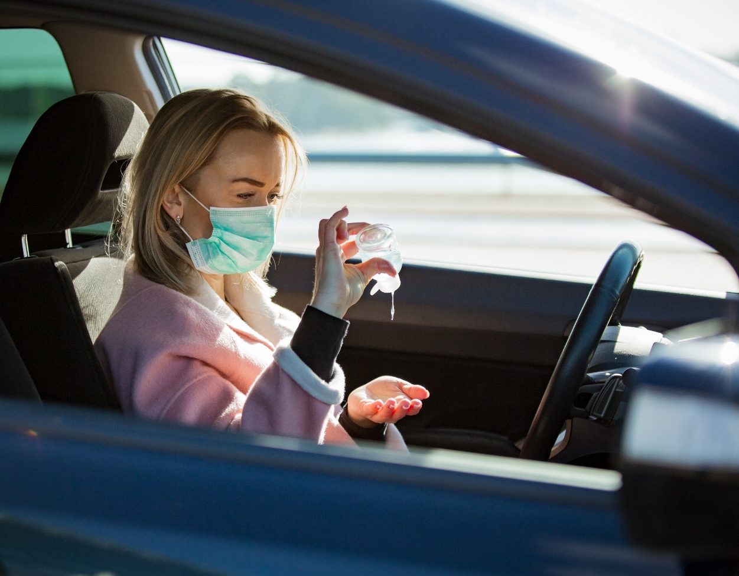
What employers should do
Workers in vehicles
Limit essential work travel and ban non-essential travel.
For instances where work travel is required, consider practices to encourage physical distancing between workers.
Follow other preventative measures related to cleaning and hygiene.
Notes:
Practices for encouraging physical distancing between workers in vehicles
Limit essential work travel, and eliminate all non-essential work travel.
Whenever possible, workers should travel alone in their vehicles. If that is the case, employers must implement all of the necessary safeguards related to working alone or in isolation, to ensure the safety of these workers.
If multiple workers are travelling in the same vehicle, measures that may be taken to ensure appropriate distance include:
Having workers sit one to a seat, with riders staggered to allow maximum distance between them
Adjusting the number of workers transported per trip
Increasing the total number of trips needed to transport workers to a worksite. These measures may mean using larger vehicles to ensure maximum spacing or using multiple vehicles.
If it is not possible to ensure 2 metres of distance between workers in a vehicle through these measures, the employer must consider other control measures, such as PPE where appropriate.
Employers must also implement a process that allows for physical distancing when loading and unloading vehicles. Workers waiting for loading/unloading should maintain physical distancing while remaining safely away from traffic.
Preventative measures related to cleaning and hygiene and travelling
Employers should have hand washing facilities or sanitizing stations available to workers as they enter and exit the vehicle.
Employers must ensure that high-contact surfaces within the vehicle are routinely cleaned. These include seatbelts, headrests, door handles, steering wheels, and hand holds.
Source: Prevention COVID-19 Info Hub

Slide 14
What employers should do
Hygiene and training
Enhance cleaning and hygiene measures:
Provide supplies.
Put up reminders for personal hygiene practices.
Remove shared items.
Disinfect high-contact areas and items.
Train, supervise, and document.
Notes:
Cleaning and hygiene
Ensure workers are provided with appropriate supplies, such as soap and water, hand sanitizer, disinfectant wipes, nitrile gloves and garbage bags, and sufficient washing facilities.
Remind staff of effective personal hygiene practices. Add signage about best practices for personal hygiene for customers who may interact with your workers.
Remove shared items where cross-contamination is possible (e.g., shared coffee and water stations and snack bins).
Enhance cleaning and disinfecting practices in high-contact areas like door and cabinet handles, keyboards, and light switches. Incorporate end-of-shift wipe downs for all shared spaces.
Training, supervision, and documentation
Train your staff on changes you’ve made to work policies, practices, and procedures due to the COVID-19 pandemic and keep records of that training. Supervise your workers to ensure compliance and health/safety.
Sources:
https://www.worksafebc.com/en/about-us/covid-19-updates/covid-19-industry-information/small-business
https://www.worksafebc.com/en/about-us/covid-19-updates/health-and-safety/what-employers-should-do

Slide 15
What employers should do
Joint health and safety committees
Work with joint occupational health and safety committee (JOHSC) members or worker representatives to:
Identify and find solutions to workplace health and safety issues.
Includes concerns about exposure to COVID-19.
Joint committees must continue to meet regularly as required under the Occupational Health and Safety Regulation.
Notes:
JOHSC & Worker Rep
Occupational joint health and safety committees and worker representatives play an important role in helping employers establish and maintain healthy and safe workplaces. Workplaces that have more than 9 but fewer than 20 workers need to have a worker health and safety representative, while workplaces that have 20 or more workers need a joint committee.
The committee or representative gives workers and employers a way to work together to identify and find solutions to workplace health and safety issues, which includes health and safety concerns related to COVID-19.
If you are an employer, you need to ensure that your joint health and safety committee or worker representative is operating effectively:
Ensure there is a mechanism in place where workers can raise any concerns about the risk of COVID-19 exposure at the workplace to the joint committee or worker representative.
Have committee members participate in a walk-through assessment of the work process(es) to identify potential areas of increased risk and priority action.
Ensure that the joint committee or worker representative is involved in the development of control plans for different job tasks.
Get your joint committee involved in promoting approved physical distancing measures.
Have your joint committee provide feedback on the effectiveness of control measures implemented.
Joint committees must continue to meet regularly as required under the Occupational Health and Safety Regulation. Consider holding meetings remotely for some or all participants, through the use of teleconferencing or video conferencing, to encourage physical distancing.

Slide 16
What workers should do
Know when not to come to work.
Follow preventative measures while at work:
Comply with the employer’s instructions around minimizing exposure.
Practice physical distancing, cleaning and disinfecting, and personal hygiene.
Report hazards and refuse unsafe work.
Take steps to minimize exposure to COVID-19 while away from work.
Notes:
Workers should know and understand their workplace health and safety responsibilities — and those of others. If you’re a worker, you also have three key rights: the right to know about hazards in the workplace; the right to participate in health and safety activities in the workplace; and the right to refuse unsafe work.
Know when not to come to work
The following workers must not go to work:
- Anyone with COVID‐19-like symptoms such as a sore throat, fever, sneezing, or coughing must self‐isolate at home for a minimum of 10 days from onset of symptoms, until their symptoms are completely resolved.
- Workers who have travelled internationally. In these cases, they must remain away from the workplace for at least 14 days.
- Workers who live in the same household as a confirmed or clinical COVID-19 case who is self-isolating.
- Workers who have been exposed to anyone confirmed to have COVID-19, or to anyone with possible symptoms of COVID-19, should call HealthLink BC at 811 for an assessment and to determine any necessary next steps.
Take other preventative measures while at work
If entering the workplace, workers should:
- Comply with the employer’s instructions around minimizing exposure to COVID-19. Ask your supervisor questions, where you are unclear.
- Keep at least 2 metres of distance from other people, wash your hands frequently, and/or use hand sanitizer, and clean/disinfect their work environment, as appropriate.
Report hazards and refuse unsafe work
If you have reasonable cause to believe that performing a job or task puts you or someone else at risk, you must immediately notify your supervisor or employer, who will then take the appropriate steps to determine if the work is unsafe and remedy the situation. Supervisors and employers have a responsibility to investigate the matter and fix it if possible. If the employer decides the worker's concern is not valid, they need to report back to the worker.
If a worker still views work as unsafe after a supervisor or employer has said it is safe to perform a job or task: The supervisor or employer must investigate the problem and ensure any unsafe condition is fixed. This investigation must take place in the presence of the worker and a worker representative of the joint health and safety committee or a worker chosen by the worker's trade union. If there is no safety committee or representing trade union at the workplace, the worker who first reported the unsafe condition can choose to have another worker present at the investigation.
If a worker still views work as unsafe, notify WorkSafeBC. Workers in B.C. have the right to refuse work if they believe it presents an undue hazard. Under the Workers Compensation Act, an undue hazard is an “unwarranted, inappropriate, excessive, or disproportionate” risk, above and beyond the potential exposure a general member of the public would face through regular, day-to-day activity. If the matter is not resolved, the worker and the supervisor or employer must contact WorkSafeBC. A prevention officer will then investigate and take steps to find a workable solution.
Remember to take steps to minimize exposure to COVID-19 while away from work.
Source:
https://www.worksafebc.com/en/about-us/covid-19-updates/health-and-safety/what-workers-should-do
https://www.worksafebc.com/en/health-safety/create-manage/rights-responsibilities/refusing-unsafe-work

Slide 17
Participant poll
My workplace (choose all that apply):
is effectively controlling the risk of COVID-19 exposure.
is minimally controlling the risk of COVID-19 exposure.
has no controls to reduce the risk of COVID-19 exposure.
Notes:
Now that I’ve discussed what employers and workers should be doing to control the risk of exposure to COVID-19 in their workplace, I’d like to get a sense of your assessment of how effectively your workplace is managing this risk at the current time.
[Ask the audience how they would respond to this question.]

Slide 18
Returning to safe operation
On May 6, 2020, the provincial government outlined its plan to restart B.C. safely. Employers preparing to resume operations must develop plans* to reopen safely, which includes assessing the risk of COVID-19 transmission in their workplace, and developing measures to reduce these risks.
How WorkSafeBC is partnering in B.C.’s Restart Plan
Engaging workers, employers, industry, and other stakeholders to help them understand the health and safety measures they need to have in place
General guidance to employers on returning to safe operation now on worksafebc.com
Specific resources to be developed for industries as they prepare to reopen
* WorkSafeBC will not review or approve the plans of individual employers, but during a WorkSafeBC inspection we will ask employers about the steps they have taken to protect their workers.
Notes:
Now that we’ve discussed control measures for businesses currently in operation, I’d like to talk about businesses that will be resuming operations in the future.
On May 6, the provincial government announced its plan to restart B.C. safely. I can share an overview of what their plan includes:
Government will be working closely with public health officials, businesses and labour organizations to lift restrictions in phases, gradually allowing for more social and economic activity, while closely monitoring health information to minimize the risk to the public.
B.C. is currently in Phase 1 of the restart plan. Phase 2, which will begin in mid-May, includes:
small social gatherings;
a resumption of elective surgeries and regulated health services like physiotherapy, dentistry, chiropractors and in-person counselling;
provincial parks open for day use;
opening more non-essential businesses in keeping with safe operations plans;
recalling the provincial legislature for regular sittings.
Essential businesses that have remained open during the pandemic, so far, have done so safely with the support of WorkSafeBC. To build on this successful experience, WorkSafeBC is supporting businesses as they take steps toward a successful reopening. WorkSafeBC will be developing industry-specific guidance to help employers bring workers and customers back safely. Any business restarting operations must ensure it is in compliance with the provincial health officer’s orders and in accordance with occupational health and safety guidance provided by WorkSafeBC.
The target date for the start of Phase 3, which will include opening up of additional businesses and services, is between June and September 2020, if transmission rates remain low or in decline.
Phase 4 will only be achieved when the threat of COVID-19 has been significantly diminished through widespread vaccination, broad successful treatments, evidence of community immunity, or the equivalent.
WorkSafeBC has created a “COVID-19 and returning to safe operation” page and FAQs at worksafebc.com to provide guidance to employers in developing its plans.
Source: https://news.gov.bc.ca/releases/2020PREM0026-000826, www.gov.bc.ca/restartbc

Slide 19
Returning to safe operation
Guide to reducing the risk of COVID-19
“COVID-19 and returning to safe operation” page on worksafebc.com provides a general guide to help employers develop a COVID-19 safety plan
Employers’ plan to reduce the risk of exposure will address how:
Your workplace is organized and arranged
Some specific activities are carried out
You clean and sanitize
Changes and precautions will be communicated to everyone at the workplace
Notes:
The information on our website will help you develop a plan to ensure you are minimizing the risk of COVID-19 appropriately, and that your business can operate safely. Note that this information and guidance represents the minimum requirements and you may identify additional risks and measures specific to your business.
Our website provides detailed information on the steps to follow to develop your plan. Those steps are:
Assess the risk at your workplace
Implement measures to reduce the risk
Develop policies around who can be at the worksite, including policies around sick workers and travellers.
Develop communication plans and training
Monitor your workplace and update your plans as needed
Assess risks arising from resuming operations
Source: https://www.worksafebc.com/en/about-us/covid-19-updates/health-and-safety/covid-19-returning-safe-operation

Slide 20
WorkSafeBC’s support

Slide 21
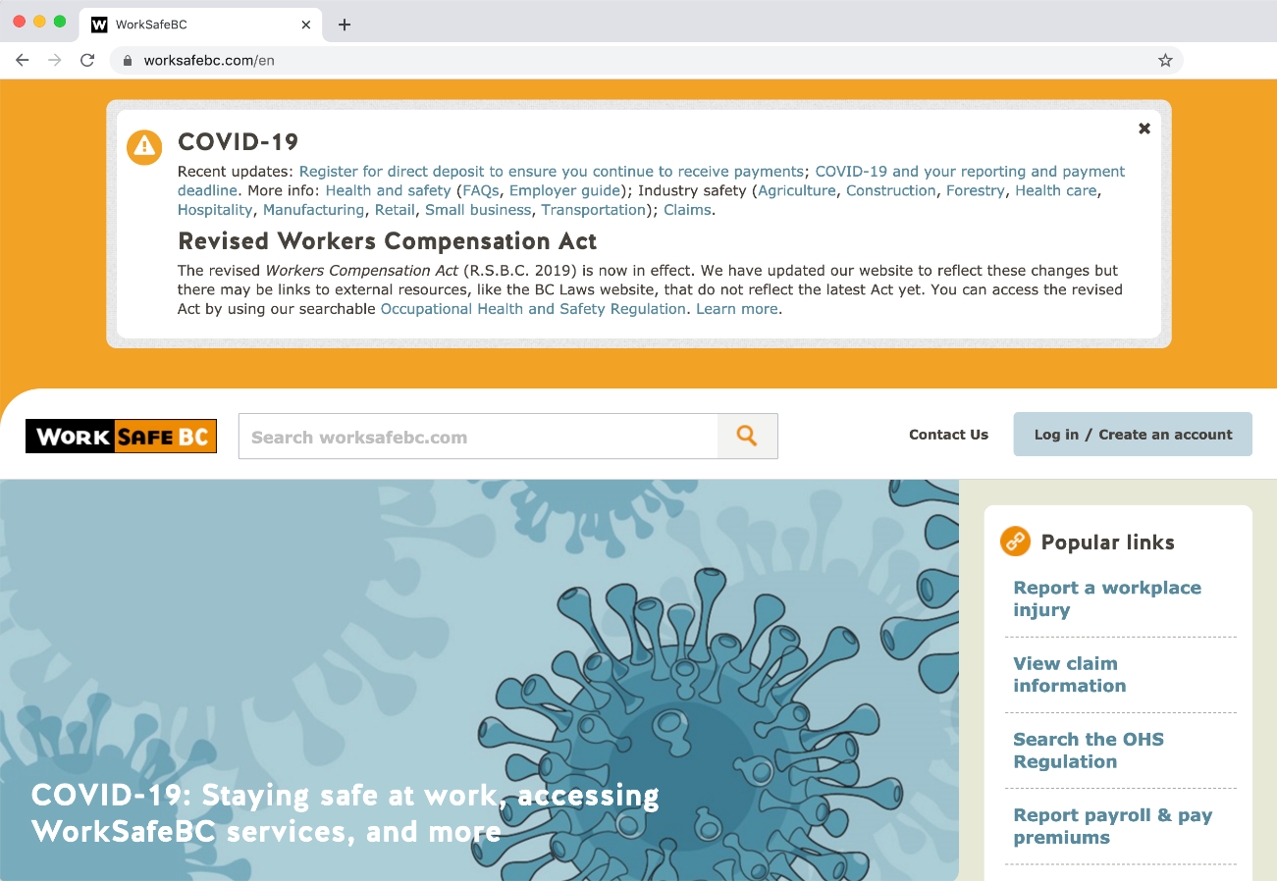
Accessing WorkSafeBC services
WorkSafeBC has been deemed an essential service.
Check worksafebc.com for regular updates and announcements.
We are committed to continuing to provide core services for workers and employers around the province, which includes helping employers prevent workplace injury, illness, and disease.
Notes:
WorkSafeBC continues to monitor the COVID-19 outbreak to determine how we can best support workers, providers, and employers around the province. Check WorkSafeBC.com for regular COVID-19-related updates and announcements.
You can access our COVID-19 information and resources by clicking on the image on the WorkSafeBC.com home page. Links to recent updates and specific COVID-19 information can also be accessed at the top of every page of the website. Our website contains COVID-19 health and safety information for all employers and workers, health and safety information for specific industries, and updates on how stakeholders can access other WorkSafeBC services during this time.
Source:
https://www.worksafebc.com/en/about-us/covid-19-updates

Slide 22
WorkSafeBC’s prevention efforts
Prevention field officers and occupational health and safety consultants are still performing inspections, education, and consultations.
Online resources:
General health and safety information for all workers and employers
Preventing exposure to COVID-19 in the workplace: A guide for employers
FAQs
Industry information pages
Announcements and updates
E-newsletter and social media
Prevention Information Line:
Workers and employers can speak to a prevention officer to get answers to questions.
If required, a prevention officer will be assigned to assess the health and safety risk at your workplace.
Call 604.276.3100 in the Lower Mainland or 1.888.621.SAFE toll-free within B.C.
Notes:
Prevention officers and OHS Specialists and Consultants are providing information to workers and employers, which focuses on the controls that the employer can use to limit exposure. Prevention officers are engaging in inspection, consultation, and education activities; while OHS consultants are engaging in consultation and education activities. This is to ensure everyone in the workplace is fulfilling their obligations and businesses have the support they need to prevent exposure to COVID-19.
Resources:
Preventing exposure to COVID-19 in the workplace: a guide that employers may use to assess the risks and controls in their workplace.
COVID-19 health and safety information: general information for all employers and workers about staying safe at work
Frequently asked questions: answers to questions from British Columbian workers and employers on how to maintain a healthy and safe workplace
Industry information pages: information on preventative measures to protect workers in specific industries
Workers and employers with questions or concerns about workplace exposure to COVID-19 can call WorkSafeBC’s Prevention Information Line at 604.276.3100 in the Lower Mainland (toll-free within B.C. at 1.888.621.SAFE). You’ll be able to speak to a prevention officer to get answers to your questions, and if required, a prevention officer will be assigned to assess the health and safety risk at your workplace.

Slide 23
Claims: Info for workers and employers
WorkSafeBC continues to support injured and ill workers and their employers during the pandemic.
Existing claims
Payments continue.
Submit expenses and manage claims through the Online Services Portal.
Service continues, including updates, treatment plans, and return-to-work procedures.
New claims
Tell your employer, seek first aid/medical attention, and report to WorkSafeBC. This includes work-related illness cases of COVID-19.
Continue to report using phone, online, fax, or mail.
Services to register, adjudicate, and make payments will continue.
If you disagree with a decision, you can request a review from the Review Division.
For more info, see the COVID-19 Claims FAQs on worksafebc.com, call the Claims Call Centre at 1.888.967.5377, or use the Email us form on worksafebc.com.
Notes:
During the COVID-19 situation, WorkSafeBC is continuing to provide the services people rely on – including the services offered to those who suffer a work-related injury or disease. Their call centres remain open, and they are continuing to adjudicate and manage new and existing claims. During these challenging times, they are still here to help.
During the COVID-19 outbreak, WorkSafeBC will continue to help when someone suffers a work-related injury or disease. Having a work-related injury or disease can be stressful at the best of times, but during this period of uncertainty caused by COVID-19, its important workers understand the support they can continue to access from WorkSafeBC and what to do if they think they have a work-related case of COVID-19. It’s also important for employers to understand and continue fulfilling their responsibilities during the claims and return-to-work process and to understand what to do if one of your workers has a work-related case of COVID-19.
Please note that WorkSafeBC staff may be contacting you from a private phone number during this public health emergency. If your phone is set up to block calls from private or anonymous numbers, you may miss their call. Please consider changing your phone settings temporarily in order to receive service.
Workers with an existing claim
- WorkSafeBC continues to pay wage-loss and pension benefits as scheduled.
- You can submit health care expense reimbursements to WorkSafeBC through the online services portal.
- If your workplace shuts down temporarily while you are on modified duties or a graduated return to work, you will receive wage-loss benefits from WorkSafeBC for the duration of your scheduled graduated return-to-work plan and/or the period of time that you are unable to work due to your injury. Please refer to their COVID-19 claims FAQs on their website for more detailed information.
You will continue to receive important information about your claim, including benefit and treatment plan updates. If you have any questions, please contact the claims officer who is handling your claim, or our Claims Call Centre if you don't have an officer's contact info, for assistance.
Employers with existing claim
-online tools are available to monitor a worker’s claim status, view correspondence about the claim, and submit claims information. You can also view your company's monthly claims costs and access a variety of online services.
Workers looking to file a new claim
Workers can continue to report a workplace injury or disease during this time, and can do so online or by phone. We will continue to register, adjudicate, and make payments on new time-lost claims.
If you’ve had a work-related exposure to COVID-19, please refer to our COVID-19 claims FAQs below, which includes information on when you should report an illness to WorkSafeBC.
If you are worker who is submitting a claim for a COVID-19 virus infection contracted through a work-related exposure, you can file a claim as you would with any other workplace injury or disease. See How workers report a workplace injury or disease.
Reaching us
We are preparing contingency plans to ensure we can continue to deliver essential services to workers and employers if the situation escalates, while supporting the direction of public health agencies to slow the progression of COVID-19 through physical distancing practices.
Workers who have filed a claim can use our online services to manage their claim. If you still have questions after viewing your claim online, please call your claims officer. Your officer will return your call as soon as possible.
Workers can also contact our Claims Call Centre if they don't have a claims officer's contact info or need assistance with receiving their payments through direct deposit.
As part of our adjustments to better serve you during the COVID-19 outbreak, you can now can submit your claim questions confidentially and securely through their “Email us” form on the website.
Submitting and managing reviews
If you disagree with a decision made by WorkSafeBC on a claim, assessment, or health and safety enforcement matter, you can request a review of the decision from the Review Division. We are continuing to receive requests for review and are completing as many decisions as possible during the COVID-19 outbreak. Learn more about Submitting and managing reviews during the COVID-19 outbreak.
Source:
https://www.worksafebc.com/en/about-us/covid-19-updates/claims
https://www.worksafebc.com/en/about-us/covid-19-updates/claims/information-for-workers
https://www.worksafebc.com/en/about-us/covid-19-updates/claims/information-for-employers
https://www.worksafebc.com/en/about-us/news-events/announcements/2020/April/convenient-online-option-for-claim-questions

Slide 24
Additional resources

Slide 25
Public health agency websites
For more information, please see the COVID-19 pages on the following websites:
BC Centre for Disease Control
Office of the provincial health officer
HealthLinkBC
COVID-19 Symptom Self-Assessment Tool (BC Ministry of Health)
Call
1.888.COVID19 (1.888.268.4319): For non-medical information about COVID-19. Available 7:30 a.m.–8 p.m., 7 days a week.
811 (HealthLink BC): To talk to a nurse if you need advice about how you are feeling and what to do next.
Notes:
Links to these resources can be found on our main “COVID-19 Health & Safety” page on worksafebc.com (https://www.worksafebc.com/en/about-us/covid-19-updates/health-and-safety).
BC Centre for Disease Control: http://www.bccdc.ca/health-info/diseases-conditions/covid-19
Office of the provincial health officer: https://www2.gov.bc.ca/gov/content/health/about-bc-s-health-care-system/office-of-the-provincial-health-officer/current-health-topics/covid-19-novel-coronavirus
HealthLinkBC: http://www.healthlinkbc.ca/
Symptom self-assessment tool: https://covid19.thrive.health/

Slide 26
Resources for employers and businesses
BC Centre for Disease Control: COVID-19 information for employers and businesses
The Government of BC: Business Continuity Planning Checklist
Small Business BC: COVID-19 Support Service for BC Businesses
Canadian Centre for Occupational Health and Safety (CCOHS): Online products and resources
Notes:
The British Columbia Centre for Disease Control has COVID-19 information specifically for employers and businesses.
The Government of BC has developed a Business Continuity Planning Checklist to help businesses prepare staff and operations for potential business disruptions during the COVID-19 outbreak.
Small Business BC operates the new B.C. Business COVID-19 Support Service, which will serve as a single point of contact for any business throughout the province looking for information on resources available during the COVID-19 pandemic.
The Canada Centre of Occupational Health and Safety (CCOHS) has developed a number of resources, including fact sheets and workplace posters outlining effective hygiene practices to help reduce the risk of exposure.

Slide 27
Psychological health and safety during a pandemic
Notes:
[OPTIONAL CONTENT]

Slide 28
Mental Health: Helping your workers cope
Psychological health is of equal importance to physical health.
Here’s how you can help:
Support the mental well-being of workers by helping them manage stress, anxiety and uncertainty created by the COVID-19 outbreak.
Leverage existing resources
Managing COVID-19 Stress, Anxiety and Depression (Ministry of Mental Health and Addictions)
Mental Health and Psychosocial Considerations During COVID-19 Outbreak (World Health Organization)
Coronavirus: Managing Stress and Anxiety (Canadian Mental Health Association)
Mental Health and COVID-19 (Conference Board of Canada)
Taking Care of Your Mental Health (COVID-19) (Public Health Agency of Canada)
Notes:
COVID-19 has impacted businesses, livelihoods, and lifestyles in very challenging ways, particularly small businesses, and workers may be affected by the anxiety, stress, and uncertainty created by the outbreak. It’s important to remember that mental health is just as important as physical health, and employers should take measures to support mental well-being and health.
Workers in the workplace may also be affected by the anxiety and uncertainty created by the COVID-19 outbreak. It’s important to remember that mental health is just as important as physical health, and to take measures to support mental well-being. This could help them be more effective at work, take care of themselves, and they may even be able help the people they work with.
Here are some resources that can assist with maintaining mental health in the workplace during this time.
Managing COVID-19 Stress, Anxiety and Depression (Ministry of Mental Health and Addictions) - Tips and resources on things we can do as individuals and collectively to deal with stress and support one another during these challenging times.
Mental Health and Psychosocial Considerations During COVID-19 Outbreak (World Health Organization) – These mental health considerations were developed by the WHO’s Department of Mental Health and Substance Use as messages targeting different groups to support for mental and psychosocial well-being during COVID-19 outbreak.
Coronavirus: Managing Stress and Anxiety (Canadian Mental Health Association, Kelowna) – Tips and information on how to reduce and manage anxiety in the workplace due to the COVID-19 outbreak.
Mental Health and COVID-10 (Conference Board of Canada) – Videos on different aspects of mental health, including coping with anxiety, job loss, and dealing with isolation.
Tactics for maintaining mental fitness during COVID-19 (Conference Board of Canada) – Series of recorded webinars on mental health and coping strategies.
Taking Care of Your Mental Health (COVID-19) (Public Health Agency of Canada) – Printable two-page poster with mental health tips and resources.
Source:
https://www.worksafebc.com/en/about-us/covid-19-updates/covid-19-industry-information/small-business
https://www.worksafebc.com/en/about-us/covid-19-updates/health-and-safety/staying-safe-at-work#mentalhealth

Slide 29
Questions?
Thank you!
Notes:
I’m always interested in learning more about the health and safety needs and challenges in the [insert industry] industry, and am here to help you with OHS strategies, which ultimately will help prevent worker injuries, illnesses, and fatalities.
I’m also always looking for “success stories” of effective injury prevention strategies to share with other employers and for our publications.
If you need support or have ideas to share, please feel free to contact me.

